Slide 1
Chapter 23
ASP.NET 2.0 Web Pages and Web Controls

Slide 2
Objectives
Web-centric concepts: HTTP, HTML, client-side, and server-side script
The role of web server
The composition of ASP.NET
How to work with ASP.NET web controls

Slide 3
Content
Architecture of Web applications
The role of HTML
The role of Client-Side Scripting
Introduction to ASP.NET
ASP.NET programming model
ASP.NET programming basics
ASP.NET Web controls
Working with Master pages
The role of Validation controls

Slide 4
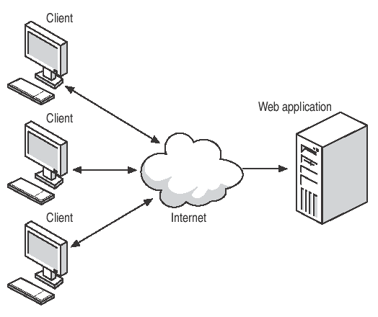
Architecture of Web applications

Slide 5
Architecture of Web applications
Web application
  collection of files (*.htm, *.asp, *.aspx, image files, etc.) and related components (such as a .NET code library)
  stored within a particular set of directories on a given web server.
Web server
  software product in charge of hosting your web applications
  provides a number of related services such as integrated security, File Transfer Protocol (FTP) support, mail exchange services, and so forth.

Slide 6
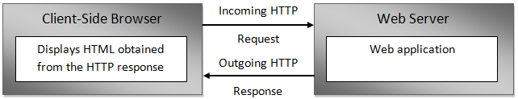
Architecture of Web applications
HTTP (Hyper Text Transfer Protocol) is a text-based protocol that is built upon a standard request/response paradigm.
The HTTP request and response cycle

Slide 7
Architecture of Web applications
Working with IIS Virtual Directories
  Virtual directory vs Physical directory
The ASP.NET 2.0 Development Server
  WebDev.WebServer.exe:
    Allows developers host an ASP.NET 2.0 web application outside the bounds of IIS
    Helpful for team development scenarios and for building ASP.NET 2.0 web programs on Windows which does not support IIS)
    It cannot be used to test classic ASP web applications

Slide 8
The role of HTML
HTML (Hyper Text Markup Language) is a standard markup language used to describe how literal text, images, external links, and various HTML-based GUI widgets are rendered by the client-side browser
Knowledge of HTML as work with ASP.NET

Slide 9
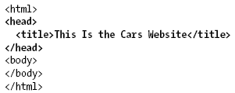
The role of HTML
HTML Document Structure
  An HTML file consists of a set of tags that describe the look and feel of a given web page.
  <html> and </html>
  <body> and </body>

Slide 10
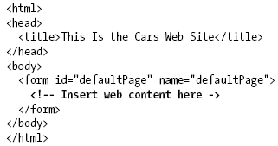
The role of HTML
HTML Form Development
  The real action of an *.htm file occurs within the scope of the <form> elements
  An HTML form is simply a named group of related UI elements used to gather user input, which is then transmitted to the web application via HTTP

Slide 11
The role of HTML
Submitting the form data
  Get method: the form data is appended to the query string as a set of name/value pairs separated by ampersands
  Post method: the form data is written to a separate line within the HTTP header
    The form data is not directly visible to the outside world
    Does not have a character-length limitation

Slide 12
The role of Client-Side Scripting
There are two major reasons to use client-side scripting:
  To validate user input before posting back to the web server
  To interact with the Document Object Model (DOM) of the target browser

Slide 13
The role of Client-Side Scripting
VBScript:
  Subset of the Visual Basic 6.0
  Only supported by IE
JavaScript:
  In no way, shape, or form a subset of the Java language
  Have a somewhat similar syntax to Java
  Not a full-fledged OOP language
  Supported by all browsers

Slide 14
Introduction to ASP.NET
ASP.NET
  is a unified Web development model
  includes the services necessary to build enterprise-class Web applications with a minimum of coding
  is part of the .NET Framework
Can code in any language compatible with the CLR

Slide 15
Introduction to ASP.NET
The major features
  Code-behind, allows to separate presentation logic from business logic
  Allows to build the GUI of a web application in a manner similar to building a Windows Forms application
  Automatically maintain state data during postbacks
  Supports master pages, themes, and web parts
  Supports a web-based configuration and management utility that maintains Web.config files

Slide 16
Introduction to ASP.NET
ASP.NET namespaces can be grouped into four major categories:
  Core functionality
  Web Form and HTML controls
  Mobile web development
  XML web services

Slide 17
ASP.NET programming model
ASP.NET web pages can be constructed using one of two approaches:
  Single-file page model:
    A single *.aspx file that contains a blend of server-side code and HTML (much like classic ASP).
    Server-side code is placed within a <script> scope
    Languages to script code: C#, VB.NET,…
  Advantages:
    Easier to deploy or to send to another developer.
    A single-file page is easier to rename.
    Managing files in a source code control system is slightly easier

Slide 18
ASP.NET programming model
  Code-behind:
    Allows to separate programming code from HTML presentation logic using two distinct files
    Works quite well when
    pages contain significant amounts of code or
    multiple developers are working on the same website
  Advantages:
    It is possible to have designers working on the markup while programmers author the C# code
    Code is not exposed to page designers or others who are working only with the page markup
    Code files can be used across multiple *.aspx files

Slide 19
ASP.NET programming model
No difference in terms of performance in both of approaches.

Slide 20
ASP.NET programming model
Interacting with the incoming HTTP Request
  ASP .NET does not support an object named Request
  All ASP.NET pages do inherit the System.Web.UI.Page.Request property, which provides access to an instance of the HttpRequest class type
  Some important members
    Browser, provides information about the capabilities of the client browser
    Form, gets a collection of Form variables
    QueryString, gets the collection of HTTP query string variables
    RawUrl, gets the current request’s raw URL

Slide 21
ASP.NET programming model
The IsPostBack property
  "postback" refers to the act of returning to a particular web page while still in session with the server
  is false if this is the user's first interaction with the page

Slide 22
ASP.NET programming model
Interacting with the outgoing HTTP Response
  The Response property of the Page class provides access to an instance of the HttpResponse type
  Allow to format the HTTP response sent back to the client browser
  Some important methods
    End(), sends all currently buffered output to the client, and then closes the socket connection
    Redirect(), redirects a client to a new URL
    Write(), writes values to an HTTP output content stream

Slide 23
ASP.NET programming basics
ASP.NET directives
  Must have at minimum a <%@Page%> directive that is used to define
    the managed language used within the page
    the name of the related code-behind file (if any)
    enable tracing support

Slide 24
ASP.NET programming basics
ASP.NET directives
  <%@Import%> directives to explicitly state the namespaces required by the current page
    is not necessary if use of the code-behind page model

Slide 25
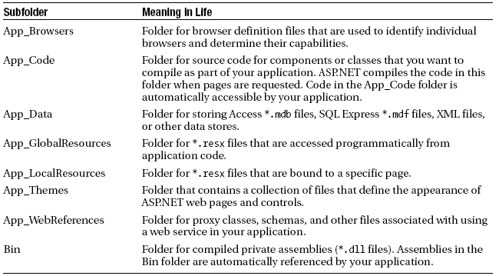
ASP.NET programming basics
Special ASP.NET 2.0 Subdirectories

Slide 26
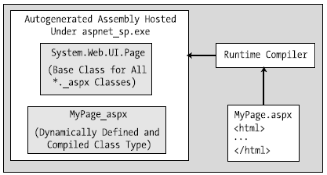
ASP.NET programming basics
Compilation cycle for single-file pages
  The compilation model for single-file pages
  This dynamically compiled assembly is deployed to a runtime-defined subdirectory under the <%windir%>Microsoft.NET\Framework\v2.0.50215\Temporary ASP.NET Files\root directory
Notes:
The HTML markup, <script> blocks, and web control definitions are dynamically compiled into a class type deriving from System.Web.UI.Page
This name of this class is based on the name of the *.aspx file and takes an _aspx suffix

Slide 27
ASP.NET programming basics
Compilation cycle for multi-file pages
  The compilation process of a page is similar to that of the single-file model
  The type deriving from System.Web.UI.Page is composed from three files rather than the expected two

Slide 28
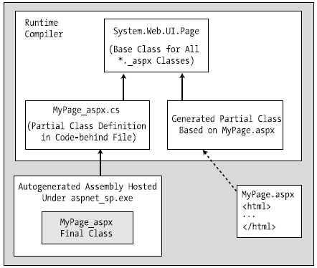
ASP.NET programming basics
The compilation model for multi-file pages
Notes:
In either case, once the assembly has been created upon the initial HTTP request, it will be
reused for all subsequent requests, and thus will not have to be recompiled.

Slide 29
ASP.NET programming basics
Every ASP.NET web page has a fixed life cycle
When the ASP.NET runtime receives an incoming request for a given *.aspx file, the associated System.Web.UI.Page-derived type is allocated into memory using the type’s default constructor
After this point, the framework will automatically fire a series of events

Slide 30
ASP.NET programming basics
The life cycle of an ASP.NET Web page
  PreInit, allocate any web controls, apply themes, establish the master page, and set user profiles
  Init, set the properties of web controls to their previous values via postback or view state data
  Load, is safe to interact with each web widget
  “Event that triggered the postback”
  PreRender
  UnLoad, perform any page-level cleanup
Notes:
This “event” simply
“Event that triggered the postback”: refers to whichever event caused the browser to perform the postback to the web server (such as a Button click).
PreRender: All control data binding and UI configuration has occurred and the controls are ready to render their data into the
outbound HTTP response
UnLoad: The page and its controls have finished the rendering process, and the page object is about to be destroyed. At this point, it is
a runtime error to interact with the outgoing HTTP response.

Slide 31

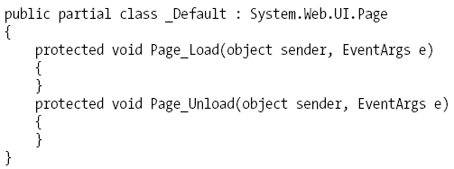
ASP.NET programming basics
To handle events for your page, <script> block or codebehind file is needed to update with an appropriate event handler using the following pattern:
Example:

Slide 32

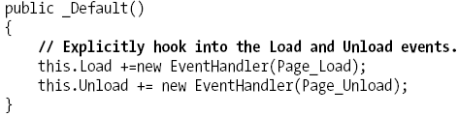
ASP.NET programming basics
The role of the AutoEventWireUp attribute
  The Load nor Unload event handlers of the _Default page will be called when AutoEventWireUp attribute set to true.
  If hook into the Load and Unload events, these events will be captured in your page regardless of the value of AutoEventWireup.

Slide 33
ASP.NET Web controls
Automatically generate the necessary HTML for the requesting browser and expose a set of events that may be processed on the web server
Can be manipulated in an OO manner from *.aspx file
Common base class is System.Web.UI. WebControls.WebControl. WebControl that derives from System.Web.UI.Control

Slide 34
ASP.NET Web controls
Qualifying Server-Side Event handling
  It is impossible to avoid the fundamental nature of browser/web server interaction
  The event-driven model of Web is not identical to that of a Windows-based UI
  Web controls expose a limited set of events, all of which ultimately result in a postback to the web server.
  Any necessary client-side event processing will require to author blurbs of client-side JavaScript/VBScript script code to be processed by the requesting browser’s scripting engine
Notes:
Blurb: lời quảng cáo

Slide 35
ASP.NET Web controls
The AutoPostBack property
  By default, this property is set to false, which disables the automatic posting of server-side events
  This technique can be helpful if wish to have the state of one widget automatically populate another value within another widget on the same page
  Example:handle the TextChanged event of the TextBox, and within the server-side event handler, populate the ListBox with the current value in the TextBox

Slide 36
ASP.NET Web controls
Categories of ASP.NET Web Controls
  Simple controls
  (Feature) Rich controls
  Data-centric controls
  Input validation controls
  Login controls
Notes:
Rich Controls: Calendar, TreeView, Wizard, etc.

Slide 37
ASP.NET Web controls
A Brief Word Regarding System.Web.UI.HtmlControls
  Are a collection of types that allow to make use of traditional HTML controls on a Web page.
  Unlike raw HTML tags, HTML controls are OO entities that can be configured to run on the server and thus support server-side event handling
  Unlike ASP.NET web controls, HTML controls are quite simplistic in nature and offer little functionality beyond standard HTML tags

Slide 38
Working with Master Pages
A master page is little more than an ASP.NET page that takes a *.master file extension
Master pages
  are not viewable from a client-side browser
  define a common UI frame shared by all pages (or a subset of pages) in your site
A master page defines various placeholder tags that contain additional content within an *.aspx file
A master page may nest additional *.master pages

Slide 39
The role of the Validation controls
Client-side form validation is quite useful
  ensure that various constraints are in place before posting back to the web server
  avoiding expensive round-trips.
Validation controls are not used to emit HTML, but are used to emit client-side JavaScript (and possibly server-side operations) for the purpose of form validation

Slide 40
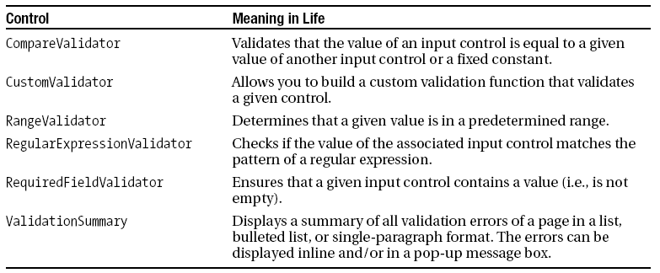
The role of the Validation controls
ASP.NET Validation controls

Slide 41
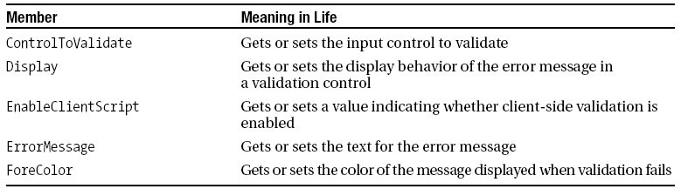
The role of the Validation controls
Common properties of the ASP.NET Validation controls

Slide 42
Summary
Some core web atoms, including HTML, HTTP , the role of client-side scripting, and server-side scripts
Examining the architecture of an ASP.NET page
Examining the use of master pages and various Web Form controls
The validation controls

Slide 43
Q & A

